Slide 1

Government of Pakistan
Ministry of National Health Services, Regulations & Coordination
Drug Regulatory Authority of Pakistan
User Manual
DRUG REGULATORY INFORMATION SYSTEM (DRIS)
(PRODUCT,BATCH AND SERIAL SUBMISSION SYSTEM)

Slide 2
Introduction
The Drug Regulatory Information System (DRIS) is an integrated online platform developed by the Drug Regulatory Authority of Pakistan (DRAP). It serves as a centralized digital system to manage the product catalogue related to pharmaceutical products. DRIS is designed to ensure transparency, efficiency, and traceability in the pharmaceutical supply chain, particularly for batch and serial data submission.
. Purpose
The purpose of the DRIS software is to:
Digitize and regulate the submission of product batches and serialization information by pharmaceutical companies.
Enable DRAP to monitor pharmaceutical production and distribution in real time.
Facilitate compliance with traceability regulations and national drug control policies.
To enforce packaging and labeling rules using GS-1 standards.

Slide 3
Benefits:-
Using DRIS offers numerous advantages to both DRAP and the pharmaceutical industry:
Centralized Product, Batch & Serial catalogue:
Pharmaceutical firms can electronically submit details of product batches and serial numbers, helping DRAP maintain an up-to-date database.
Improved Regulatory Oversight:
DRIS enhances DRAP’s ability to trace and verify products in the supply chain.
Transparency & Accountability:
Ensures that all batches released in the market are traceable and authorized.
Ease of Use:
A user-friendly interface supports smooth submission, review, and monitoring processes.
Enhanced Public Safety:
By tracking serial and batch data, DRAP can prevent counterfeit or unauthorized products from reaching the public.
Integration with Other DRAP Systems:
DRIS works in coordination with other DRAP digital platforms for cohesive regulatory management.

Slide 4
Key Functionality: Product Batch and Serial Submission
One of the core functionalities of DRIS is the submission of product batch and serialization data. Here’s what users can do:
Submit batch-wise production records for each drug product.
Upload serial numbers for each unit, carton, or pack as required.
Monitor the status of submissions (pending, approved, rejected).
Generate submission history and reports for compliance tracking.

Slide 5
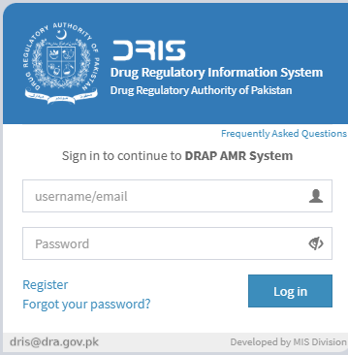
How to start
Use URL://dris.dra.gov.pk or it is available on website www.dra.gov.pk under “E-services” menu.
Login to DRIS.If you don’t have username and password then Click “Register”

Slide 6
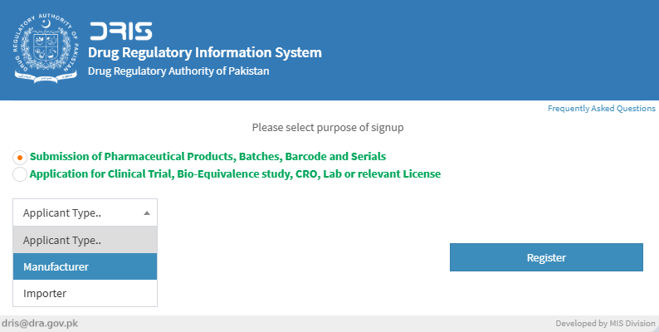
The following screen will appear. Select “Submission od pharmaceutical product…………..”.Select applicant type
and press register e.g. we select “importer”.

Slide 7
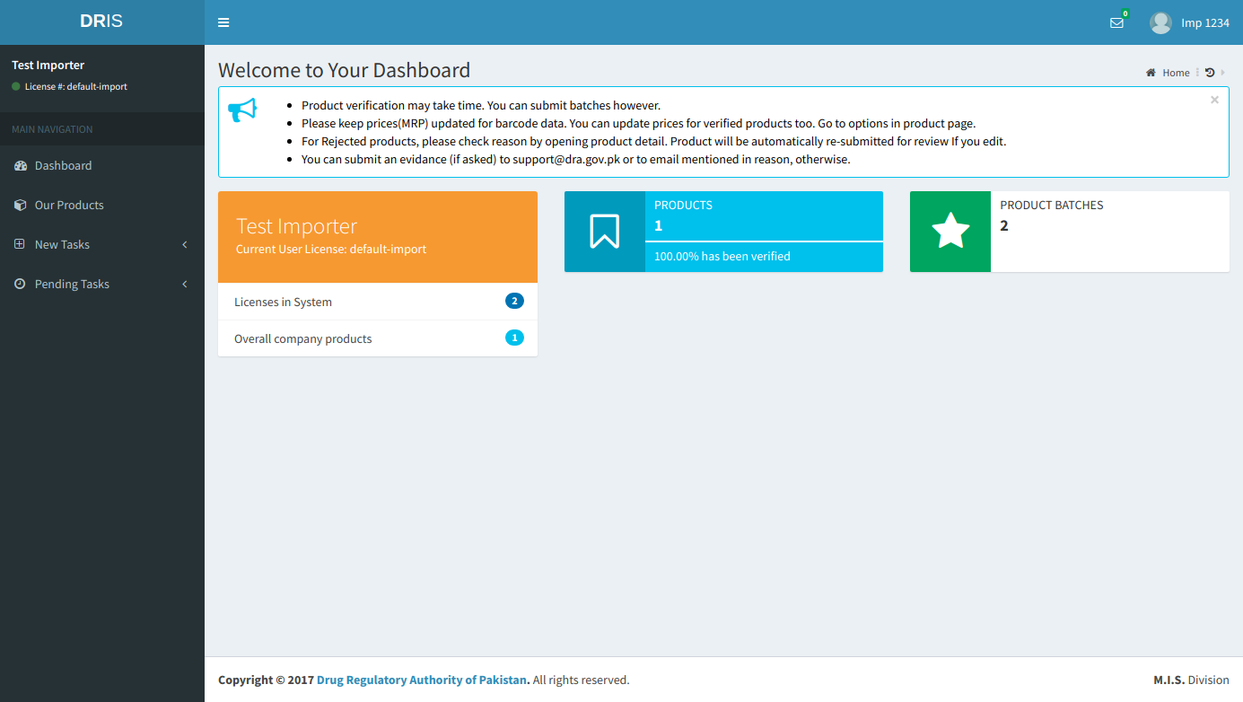

The following Dashboard will appear.

Slide 8
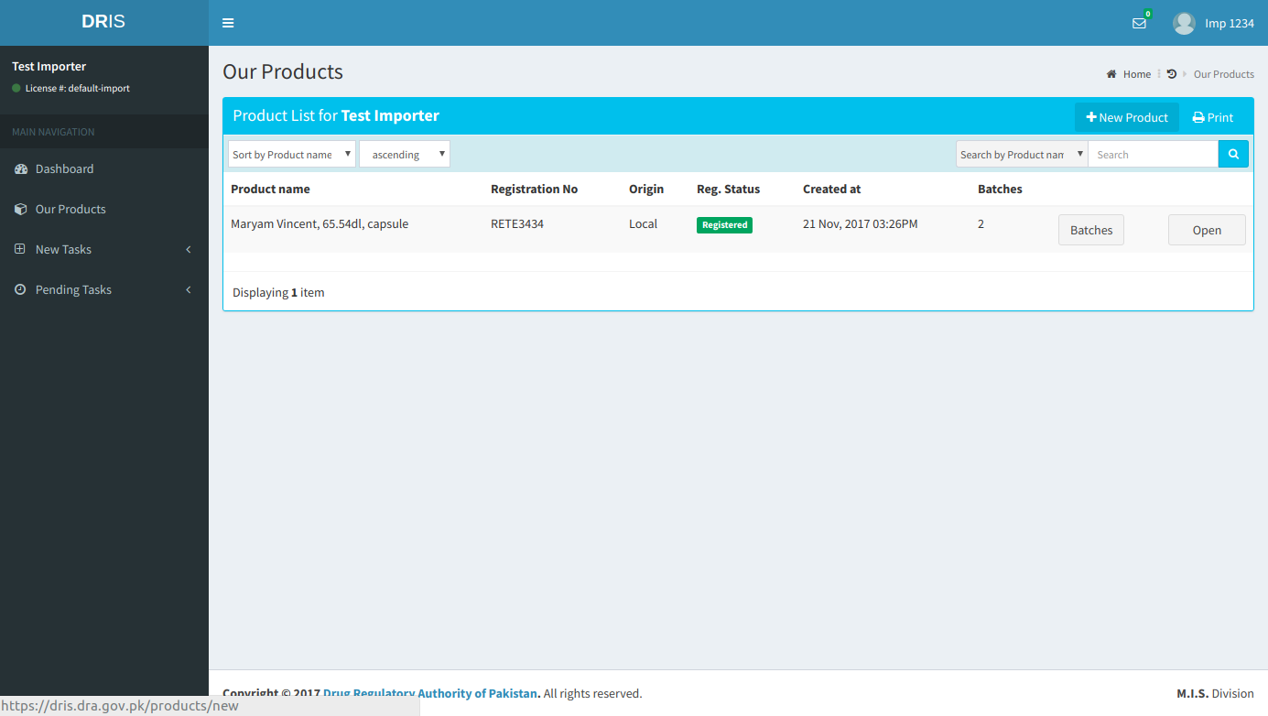
From dashboard select “Our products”. You’ll see your submitted products here.
Click “New Product” to submit a new product.

Slide 9
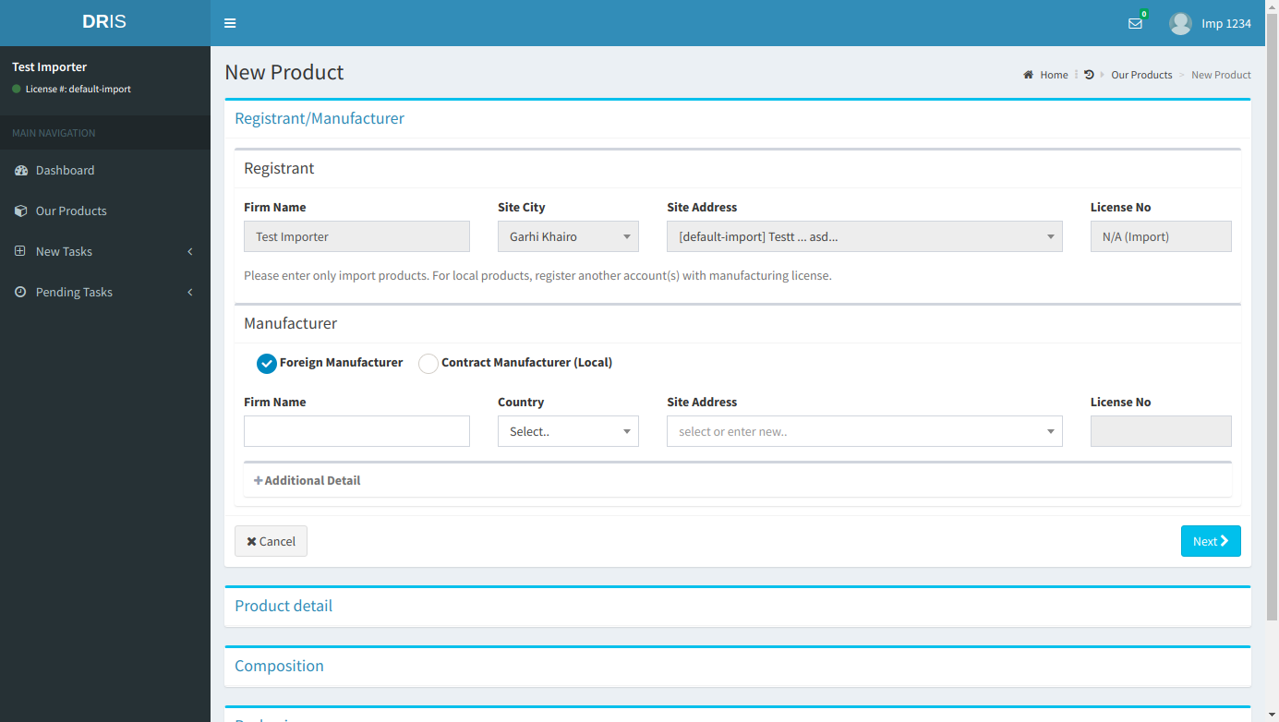
The following screen will appear enter values for the fields listed below and press “Next”

Slide 10
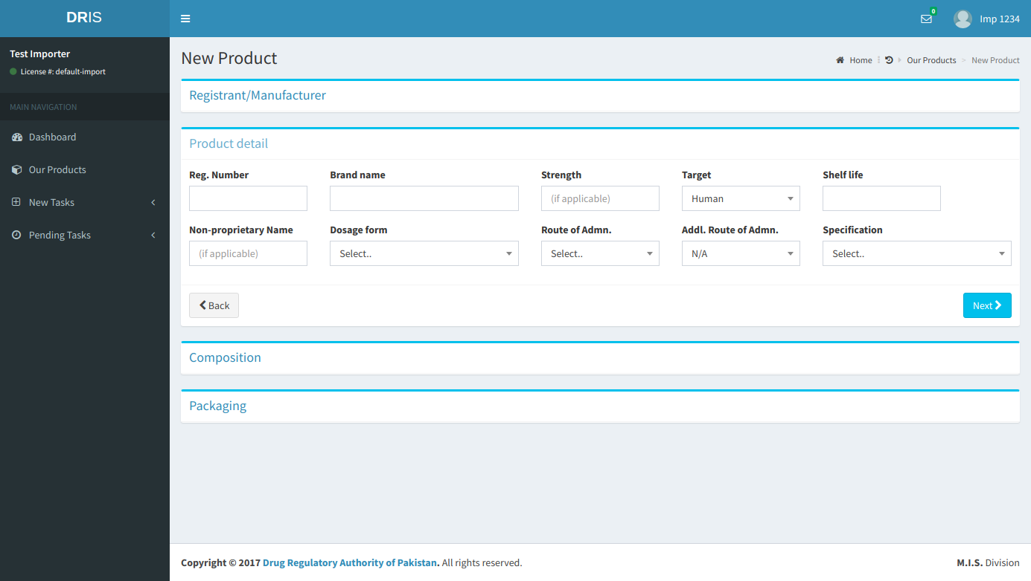
Now enter product details and press “Next”

Slide 11
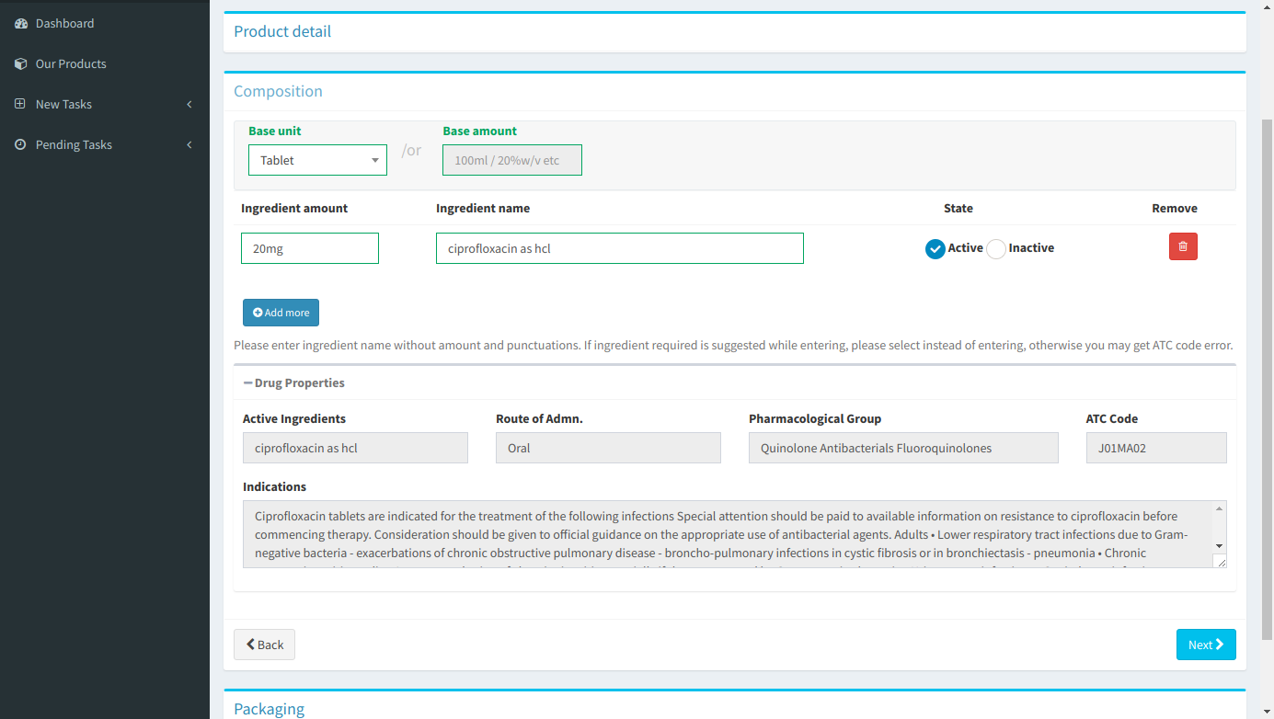
Enter composition details and press “Next”

Slide 12
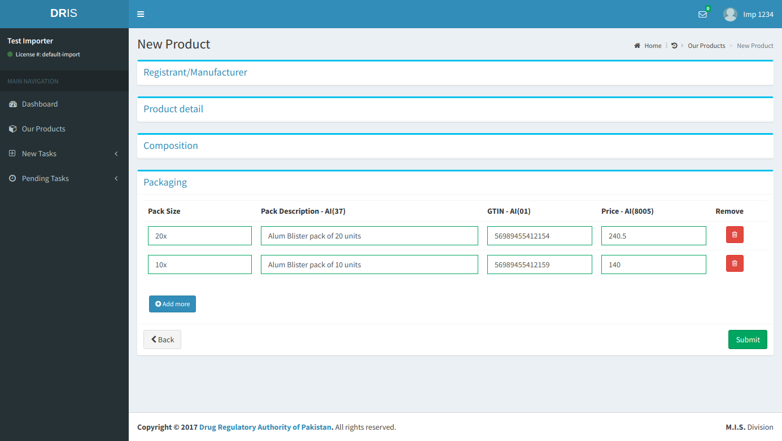
Now enter packaging details and press submit.

Slide 13
HOW TO ADD BATCH INFORMATION

Slide 14
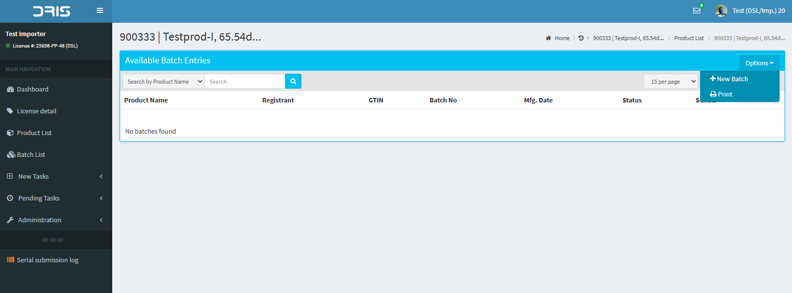
From the product option menu select batch list. In batch list there is option of “New Batch” in the
menu. Select this option to enter new batch.

Slide 15
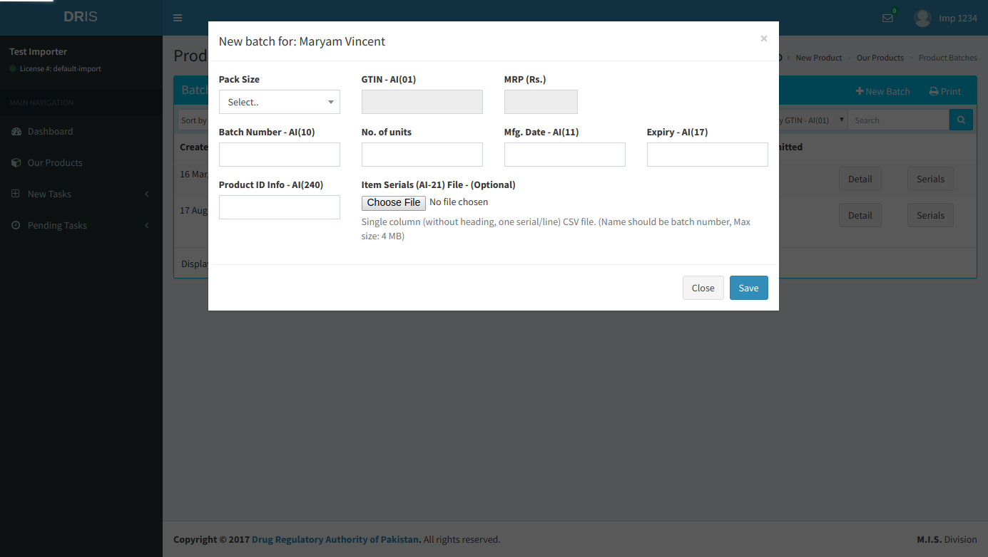
Enter batch information and press “Save”

Slide 16
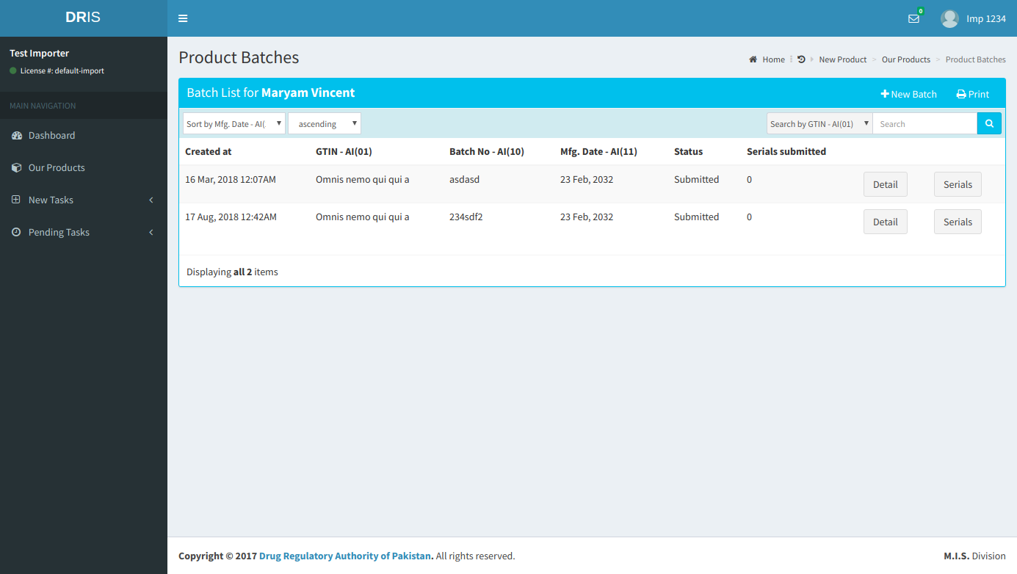
Once the batch details are submitted they will be listed as shown.

Slide 17
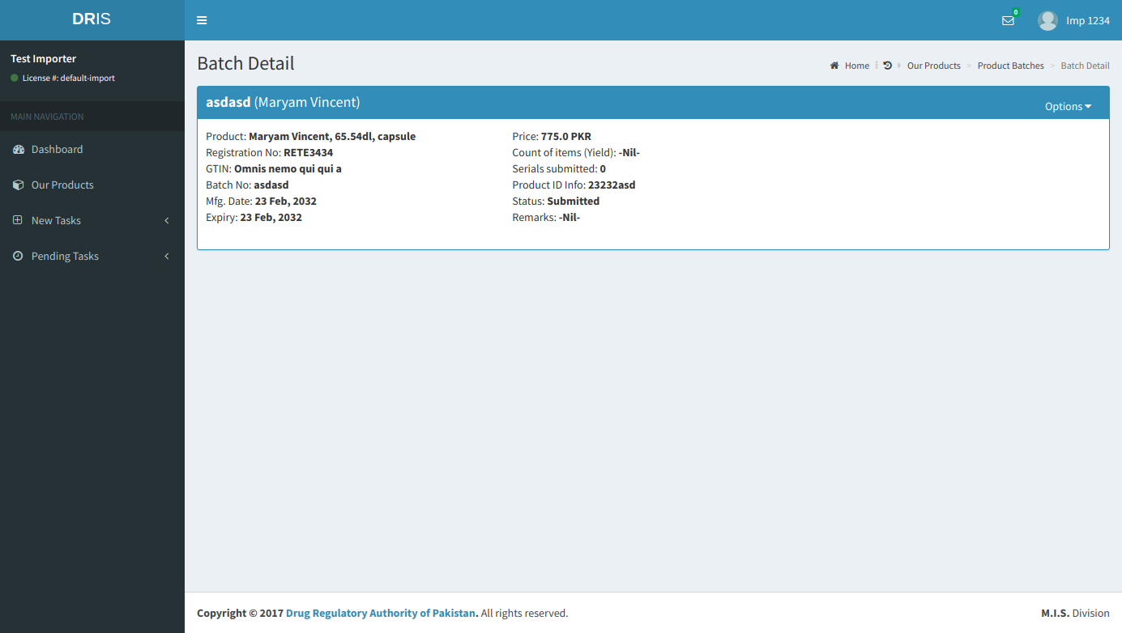
The entered batch details will be shown as follows. You can edit batch information within 15 days of entry

